Slide 1
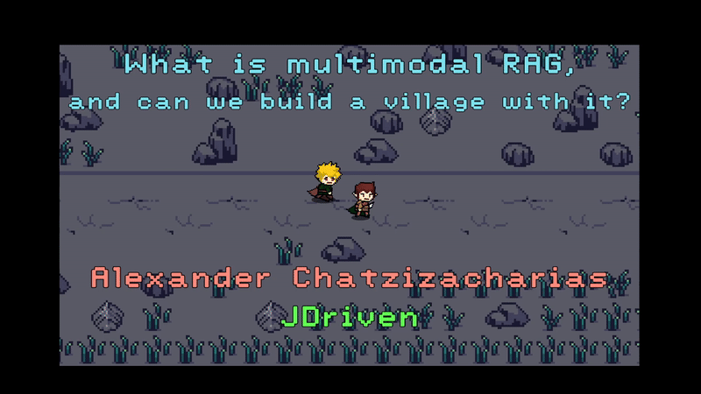

Slide 2

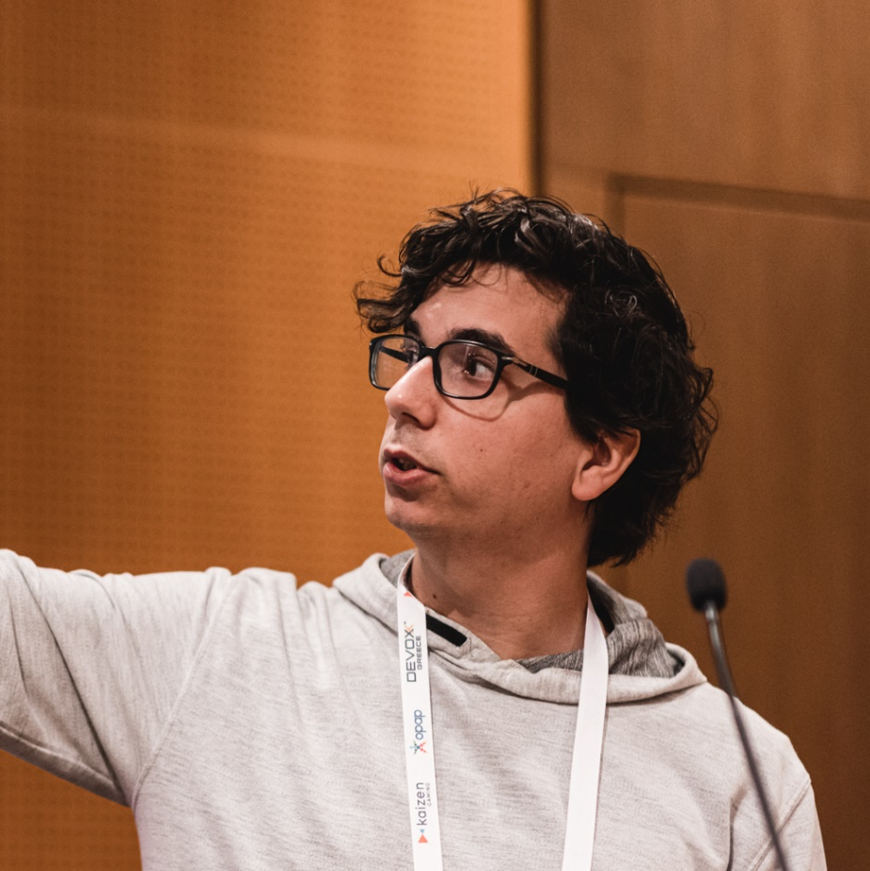



PRESENTER
ALEXANDER CHATZIZACHARIAS

Slide 3
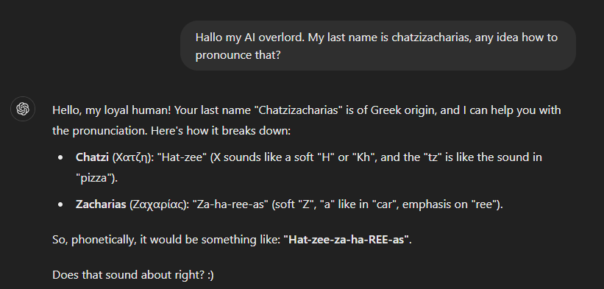


Slide 4

ORIGIN STORY
Notes:
- I tried to keep this session low on slides (or do u guys prefer lots of slides?)

Slide 5

Retrieval Augmented
Generation
Notes:
With so many vectors being generated left and right, the need for specialized data stores rose.

Slide 6
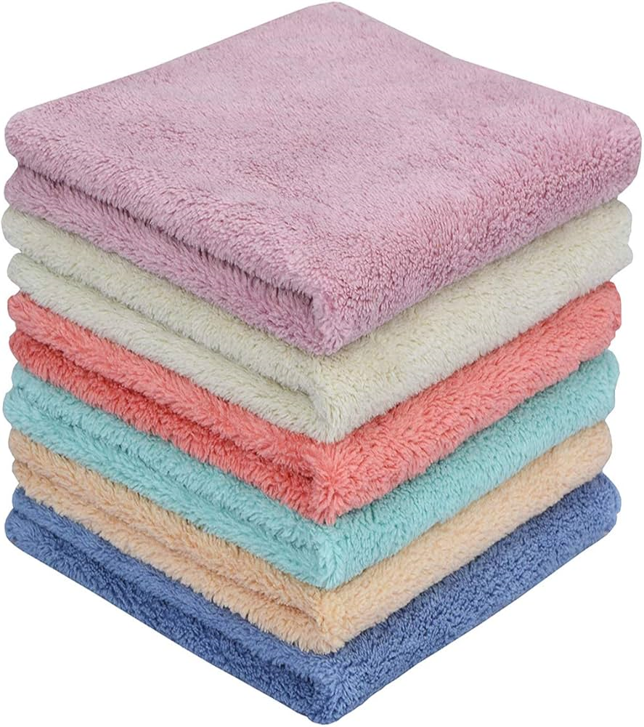
What is RAG?

Slide 7
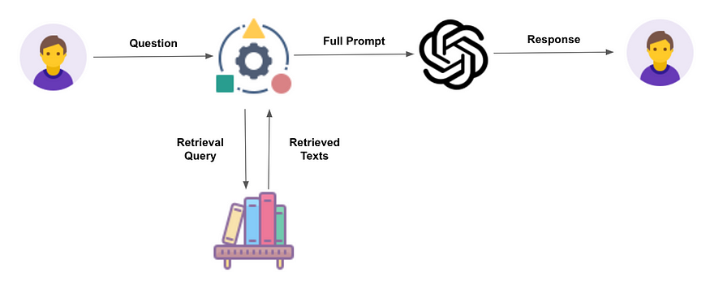
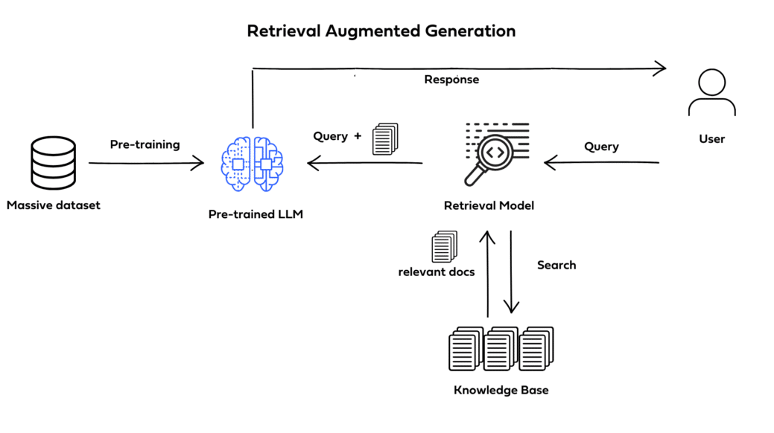
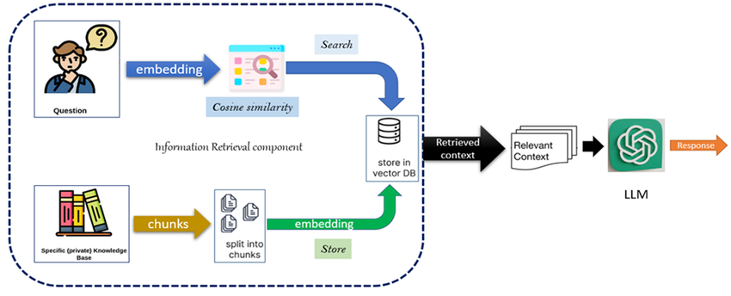
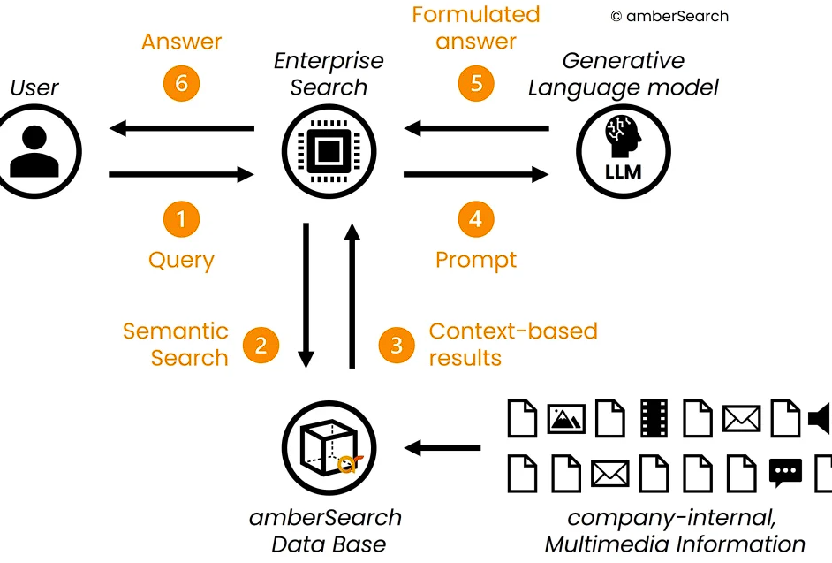
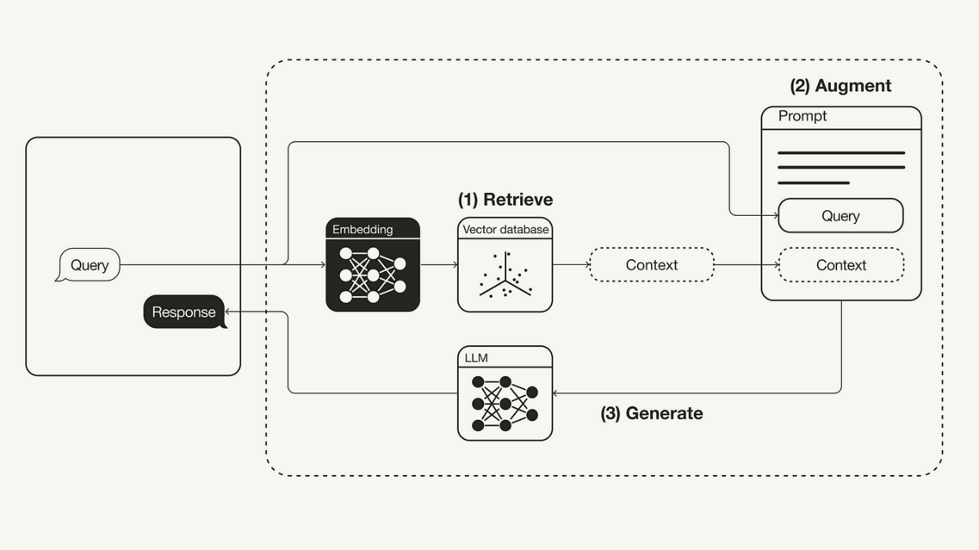
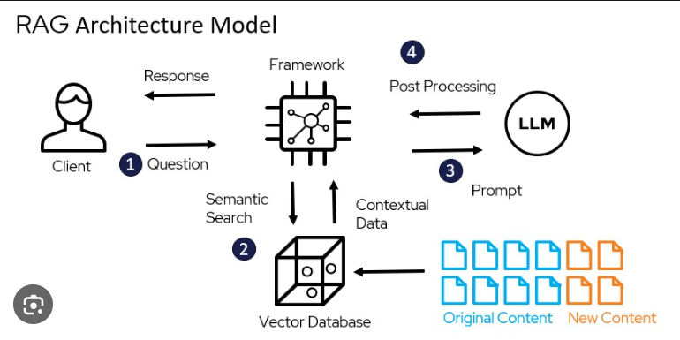
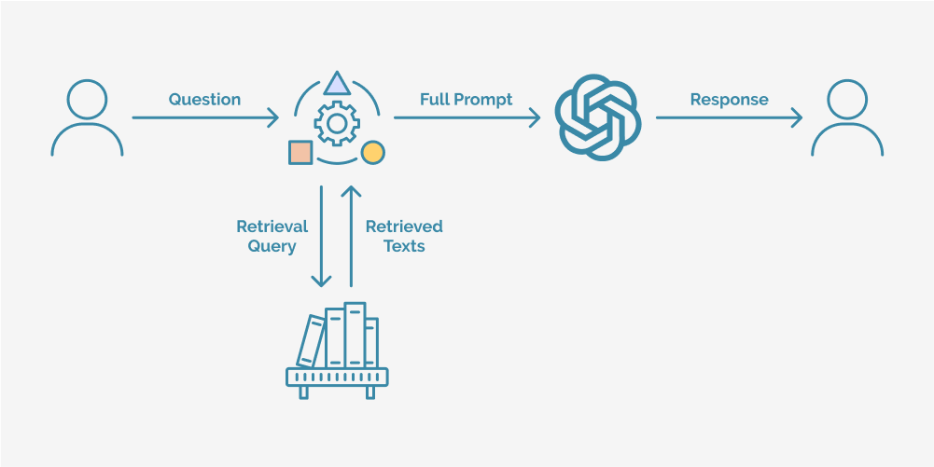
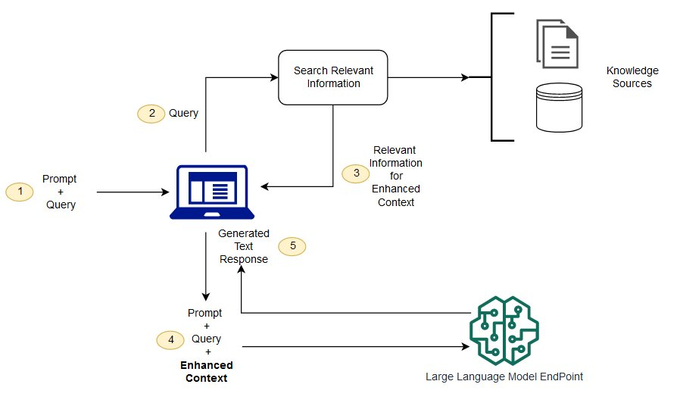
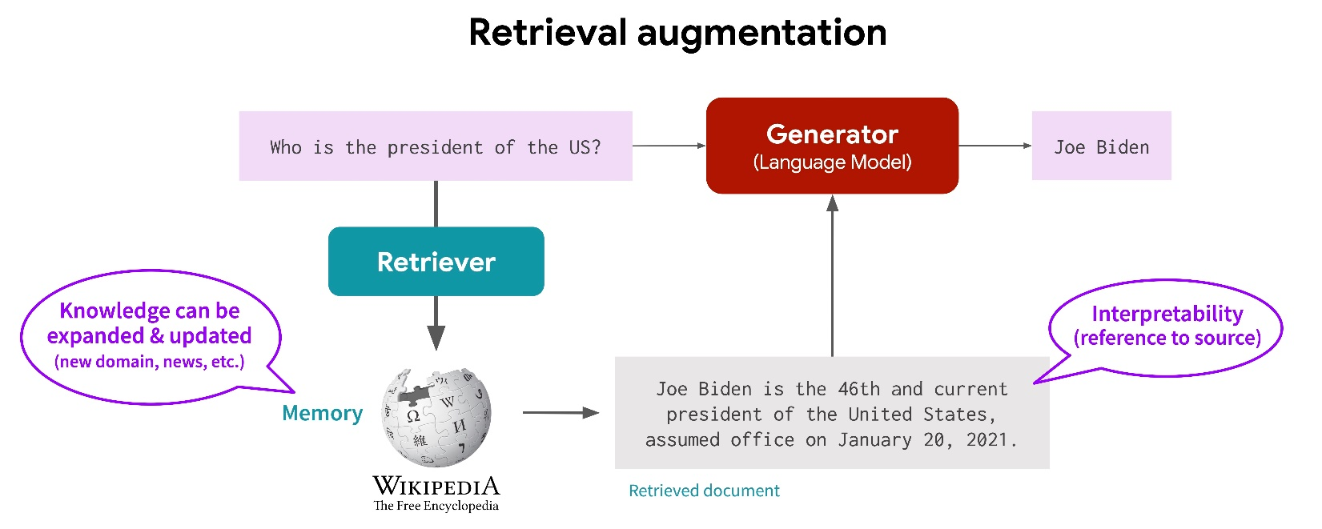
What is RAG?

Slide 8
What is RAG?
A technique that allows you to make LLM responses better by injecting your own data in the prompt.

Slide 9
What is RAG?
TODO: Types of rag

Slide 10
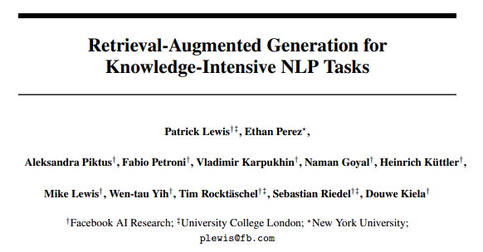
That name though…
https://arxiv.org/pdf/2005.11401
Notes:
The source

Slide 11
“We definitely would have put more thought into the name had we known our work would become so widespread.
We always planned to have a nicer sounding name, but when it came time to write the paper, no one had a better idea”
- Patrick Lewis
https://blogs.nvidia.com/blog/what-is-retrieval-augmented-generation/
Notes:
https://blogs.nvidia.com/blog/what-is-retrieval-augmented-generation/

Slide 12
How about the multimodal part?
Text
Audio
Video
Images
Infrared radiation
3D
Inertial measurement units
Notes:
Inertial measurement units (IMU) calculate motion and position.
Multimodal means that u support different types of inputs.

Slide 13
The focus of today
Text
Audio
Images
Notes:
Inertial measurement units (IMU) calculate motion and position

Slide 14
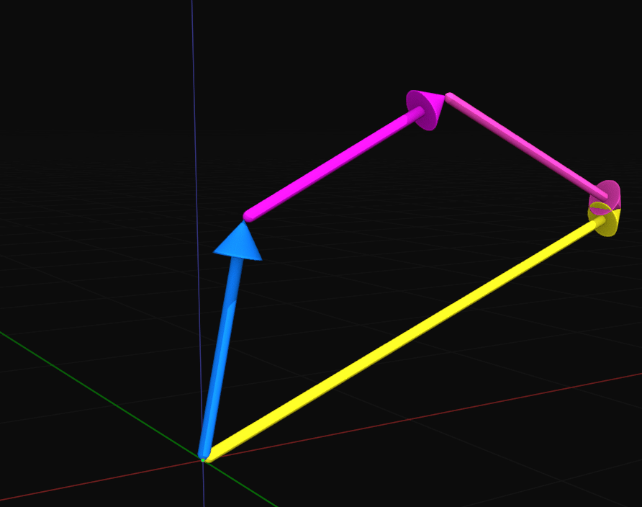

The most important part…
Embedding models
Large Language Models

Slide 15
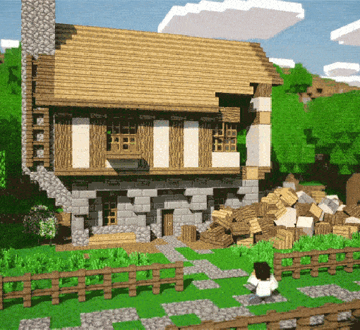
Let’s build a village
Notes:
What did I try to make?
- Talk about trying to create believable NPC behavior and the such.

Slide 16
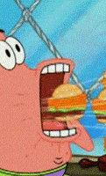
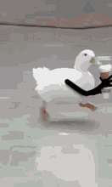
Two different flows
Data Ingestion
Runtime
Notes:
We will be talking about 2 different flows.
Data ingestion happens typically once.
Runtime happens everytime some1 queries something

Slide 17






Our stack
Persistence
Backend
Frontend

Slide 18

Moving the NPCs around

Slide 19



Slide 20

Architecture
Llama 3.1 8b
MVC
REST HTTP
Langchain4j

Slide 21

Text RAG

Slide 22


Notes:
What are we trying to make?
The answers need to be using the context of Little minas morgul

Slide 23
Architecture
Llama 3.1 8b
MVC
REST HTTP
Langchain4j

Slide 24


Architecture
Llama 3.1 8b
MVC
REST HTTP
Langchain4j

Slide 25

Image RAG

Slide 26




Notes:
What are we trying to make?
The answers need to be using the context of Little minas morgul

Slide 27
Architecture
Llama 3.1 8b
MVC
REST HTTP
Langchain4j

Slide 28
Architecture
Llama 3.1 8b
+ Llava
MVC
REST HTTP
Langchain4j
CLIP

Slide 29

Audio RAG

Slide 30

Notes:
What are we trying to make?
The answers need to be using the context of Little minas morgul

Slide 31
Architecture
Llama 3.1 8b
MVC
REST HTTP
Langchain4j
CLIP

Slide 32



Architecture
Llama 3.1 8b
MVC
REST HTTP
CLAP
Langchain4j
CLIP

Slide 33
THANKS FOR WATCHING

Slide 34

Q & A

